Slide 1
Real Metrics for Real Decisions
Kristofor Walburn

Slide 2
A bit about me
Agile Coach at VinSolutions, a division of Cox Automotive
Missouri native
Agilest since 2006
Started Lean Journey in 2014

Slide 3
Agenda for today
Vocabulary
Background on how I got started with these metrics.
Metrics and what I have learned
What does failed work cost a team?
How good are teams at estimating?
Please stop me to ask questions.

Slide 4
Vocabulary
Work Item = A User Story or a Bug
Cycle Time = Average number of calendar days to complete a work item
Throughput = Average number of work Items delivered per calendar day
WIP = Work In Progress
State = A phase in the team’s delivery process

Slide 5
Background of how we started gathering metrics
Notes:
My teams were Scrum
I had been wanting to find a way to find something beyond Velocity and Burndowns to help drive efficiency in the teams

Slide 6
My First Challenge
I had 2 Engineers and 1 QA on the team, management wanted to hire another Engineer.
I knew another QA to maximize the teams delivery efficiency.
How could I prove that with facts instead of feelings?
Notes:
First team had 3 dev 1 QA, QA could not keep up and DEV had to help out a lot.
in SCRUM, the whole team works to meet the sprint goal
in reality, dev’s want to code, not test. This leads to poor job satisfaction and people walking out the door.
How could I prove that? Team is meeting sprint goals and Team’s velocity is Stable?

Slide 7
Visualize system of the Team
Notes:
What does it take to deliver work to our customer.
What are all of the steps involved.
Capture all the states and wait queues that the work moves through on the team.
We manually recorded the date changes between each state.

Slide 8
Identifying bottlenecks
Notes:
Could not get work into QA due to lack of QA being able to keep up with testing.
Adding another engineer would lead to more work being backed up in code complete.

Slide 9
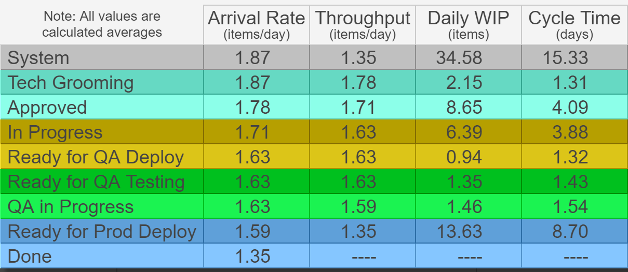
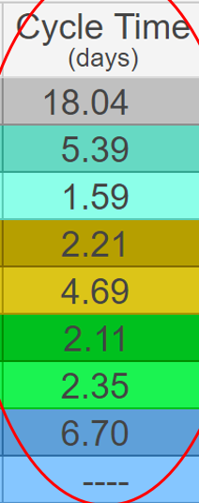
Same Team a few months later
Notes:
Added additional states to team’s process
QA Deploy Time dropped as work could be deployed quicker
Work was moving through QA faster.
Overall cycle time also improved getting work to our customers.
Throughput doubled.

Slide 10
Taking it to scale
We now pull data across 14 teams
Data, SQL, Tooling, and Patience
Learn as we go
Notes:
Please ask questions, I will learn something today.

Slide 11
What do we look at?
Arrival Rates
Throughput
Cycle Times (Total & per State)
WIP
Cycle time Scatter Plots
Variability
How Often?
Quarterly for organization
Teams decide their own review cadence
Notes:
As often as the team can consume the information and make changes to their delivery process.
We look across all teams quarterly for trends
Agile leads review monthly for more mature teams.

Slide 12
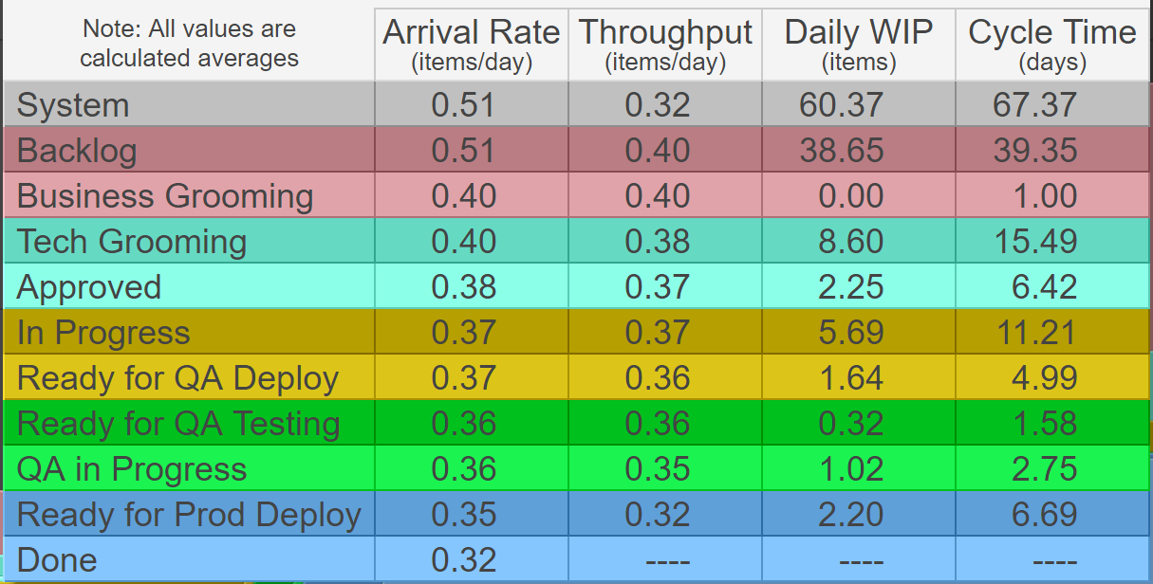
Arrival Rates vs Throughput
Notes:
This team cannot keep up with client reported bugs. Reporting Outpacing delivery by 60%, this should be close
2 dev’s pulled of team for more important work, impact of that decision is backlog of bug work.
2 contractors hired and rates are stabilizing, but have not started to work through backlog of bugs yet.
Product Owner needs to prioritize bugs over new product features.

Slide 13
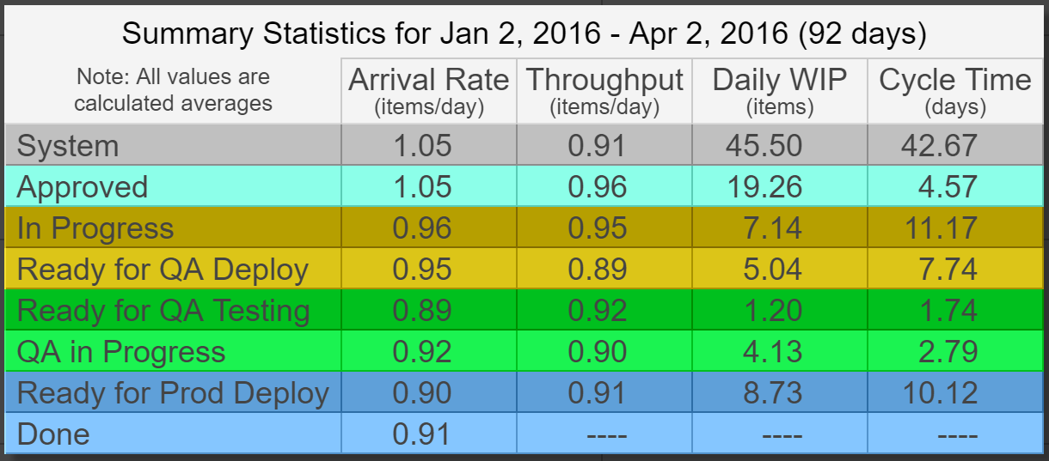
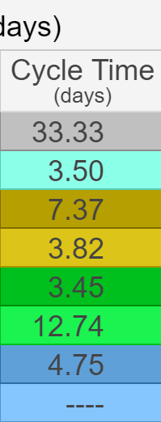
Cycle times and Throughput Measuring effectiveness of CI/CD
Notes:
This team Implemented Continuous Integration and Continuous Deployment Practices, are they paying off?
Throughput - # of work items completed each day: Increased Throughput by about 70%
Cycle Time – how long to get work out: Decreased by 22%
Getting work to QA cut by half, code to prod byt by over half, delivering value to customers.
Now investing in automation….

Slide 14
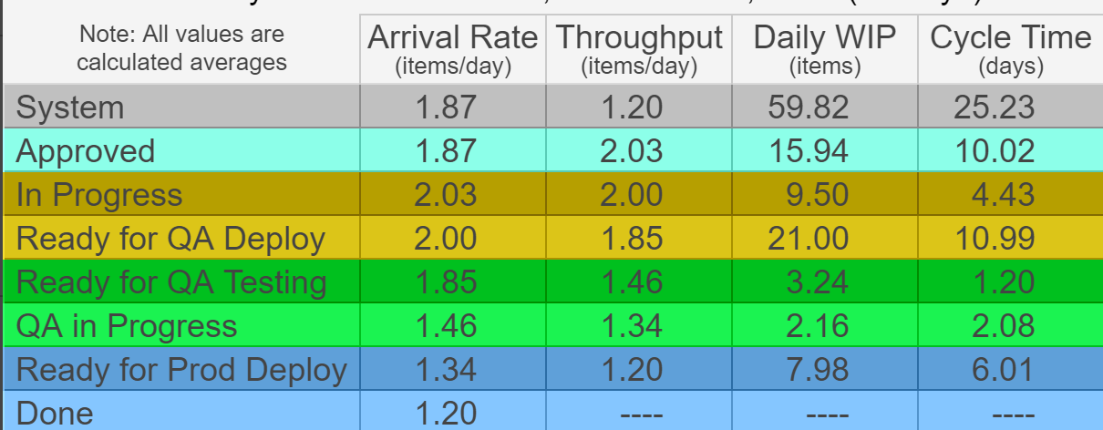
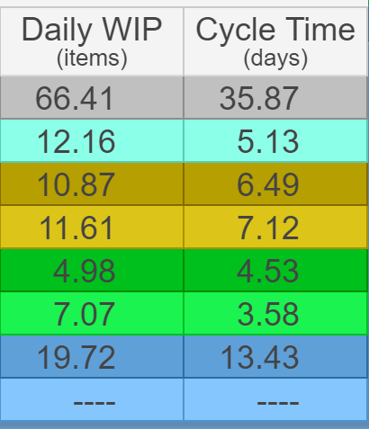
Watching WIP Problems getting work into QA
Notes:
QA environment and code branching strategy made QA code deploy’s difficult.
Modified branching strategy, same QA environment.
This has now exposed other opportunities with QA only wanting to batch work through QA and pass all at once.

Slide 15
How did we compare year over year?
cycle time change -4.67%
Throughput change 73.82%
WIP Change 64.84%
Notes:
Across all teams
Throughput 10.58 Throughput 18.39
Cycle Time 20.78 Cycle Time 19.81
Daily WIP 299.45 Daily WIP 493.62

Slide 16
How did we compare year over year?
Approved -21%
In Progress 25%
Ready for QA Deploy
-26%
Ready for QA Testing 7%
QA in Progress 6%
Notes:
All teams comparing each state.
In Progress increased due to implementing better coding practices, code reviews, unit testing. Outcomes later half of year by reducing Dealer reported incidents by 70%.
Next year expect to increase more in testing as we push for more automation, more unit tests.
Measured by Outcomes of lower support incidents and client reported bugs.

Slide 17
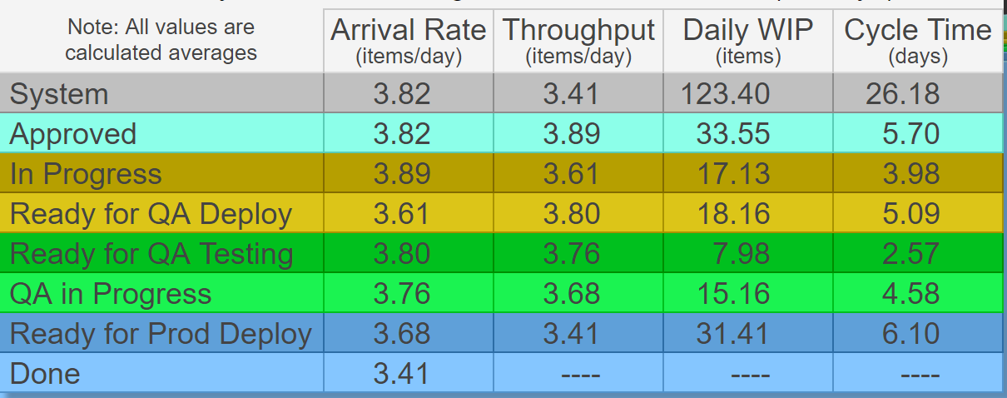
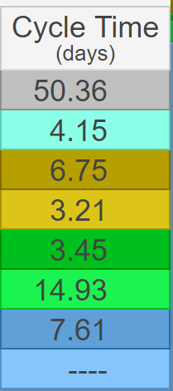
What does failed work cost us?
Notes:
This can work if you stop failed work and create bugs or move failed work back.
Almost 2x for work that fail’s QA

Slide 18
How good are we at estimating?
Size Effort Duration
1 4.74 15.34
2 8.55 24.08
3 11.91 32.54
5 20.44 45.68
Notes:
Only team of 14 that had direct correlation with point estimates.
Average story size for team is a 2.

Slide 19
How good are we at estimating?
Size Effort Duration
1 6.96 44.83
2 5.87 20.74
3 18.56 57.29
5 15.83 56.25
Notes:
Many teams look like this

Slide 20
How efficient are we at delivering?
Notes:
Look at In Progress and QA In Progress as the active states, everything else is waiting for action, a queue.
Focus on reducing the waste in the queues for maximum benefit.

Slide 21
For More Information
Kristofor.Walburn@vinsolutions.com
www.actionableagile.com

